Slide 1
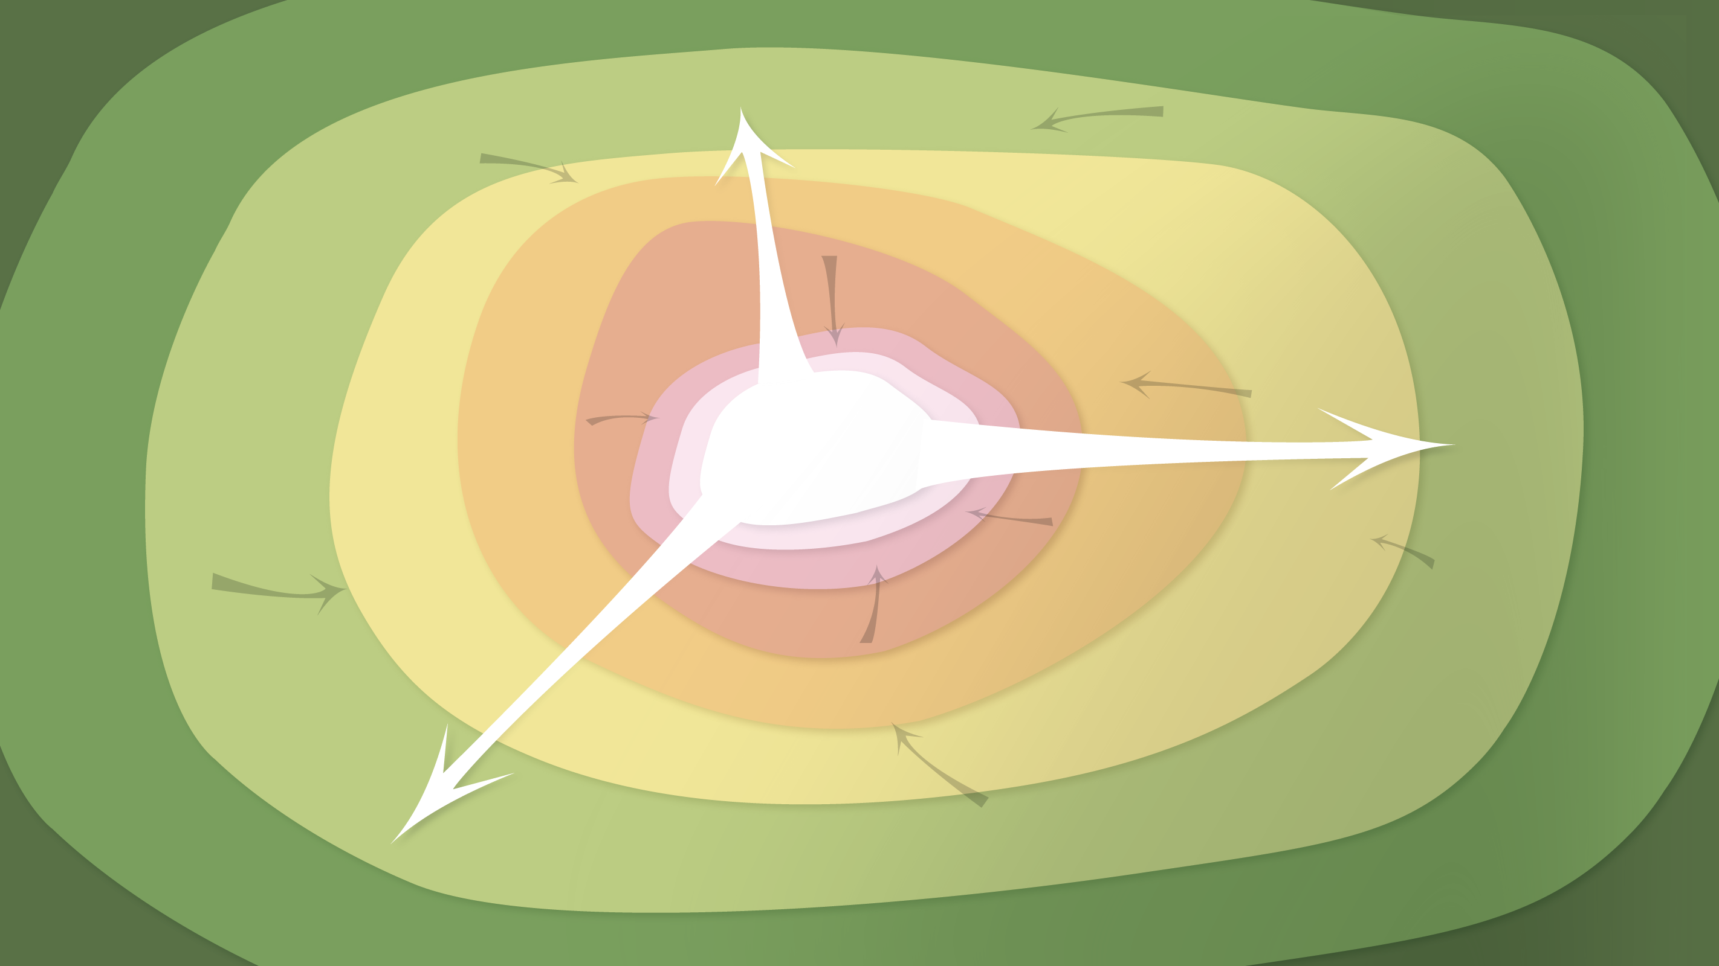
Data Management in the Research Environment
RSM 574/674 Spring 2016
Timothy Norris – tnorris@miami.edu
Angela Clark – aclark@rsmas.miami.edu

Slide 2

and Research DATA Management?
Before: Data Management Planning / Grant Process
Privacy/Security Considerations
Storage and backup strategies
File System Organization
File Naming Conventions
File Format Choice
Documentation and metadata
Roles and responsibilities in research environment
Sharing and collaboration strategies
Ownership of data
Access strategies / Access restrictions
During: Compliance and Productivity
After: Publication and/or Repository Deposit
Notes:
The Matrix - 1999
Big Data . . .
Talk to the data deluge, what are the responses in academia? In the public sector? Perhaps this is why we are here today?
NIH early data sharing requirements from grants over $500,000 – stringent controls for privacy and proprietary data
The 2011 NSF requirement to have data management plans in the grant proposals – there are program specific requirements
Most are simply two page documents with requirements to outline:
Data types to be collected
Standards to be used for metadata and data
Sharing policies (access, privacy, IP, etc.)
Re-use policies (distribution, derivatives
Plans for archival
Note that these requirements caused quite the scramble. No grant money if you could not include a plan.
Note that many foundations now also have data management requirements
Even private sector contracts require data management planning

Slide 3
and Research DATA Management?
Before: Data Management Planning / Grant Process
During: Compliance and Productivity
Follow file naming, organization and format conventions
Documentation and metadata
Acquiring and cleaning data
Regularly backup all data
Be mindful when sharing / version control
Access / privacy policy enforcement
After: Publication and/or Repository Deposit
Notes:
The Matrix - 1999
Big Data . . .
Talk to the data deluge, what are the responses in academia? In the public sector? Perhaps this is why we are here today?
NIH early data sharing requirements from grants over $500,000 – stringent controls for privacy and proprietary data
The 2011 NSF requirement to have data management plans in the grant proposals – there are program specific requirements
Most are simply two page documents with requirements to outline:
Data types to be collected
Standards to be used for metadata and data
Sharing policies (access, privacy, IP, etc.)
Re-use policies (distribution, derivatives
Plans for archival
Note that these requirements caused quite the scramble. No grant money if you could not include a plan.
Note that many foundations now also have data management requirements
Even private sector contracts require data management planning

Slide 4
and Research DATA Management?
Before: Data Management Planning / Grant Process
During: Compliance and Productivity
After: Publication and/or Repository Deposit
Publish
Deposit in a repository
Notes:
The Matrix - 1999
Big Data . . .
Talk to the data deluge, what are the responses in academia? In the public sector? Perhaps this is why we are here today?
NIH early data sharing requirements from grants over $500,000 – stringent controls for privacy and proprietary data
The 2011 NSF requirement to have data management plans in the grant proposals – there are program specific requirements
Most are simply two page documents with requirements to outline:
Data types to be collected
Standards to be used for metadata and data
Sharing policies (access, privacy, IP, etc.)
Re-use policies (distribution, derivatives
Plans for archival
Note that these requirements caused quite the scramble. No grant money if you could not include a plan.
Note that many foundations now also have data management requirements
Even private sector contracts require data management planning

Slide 5
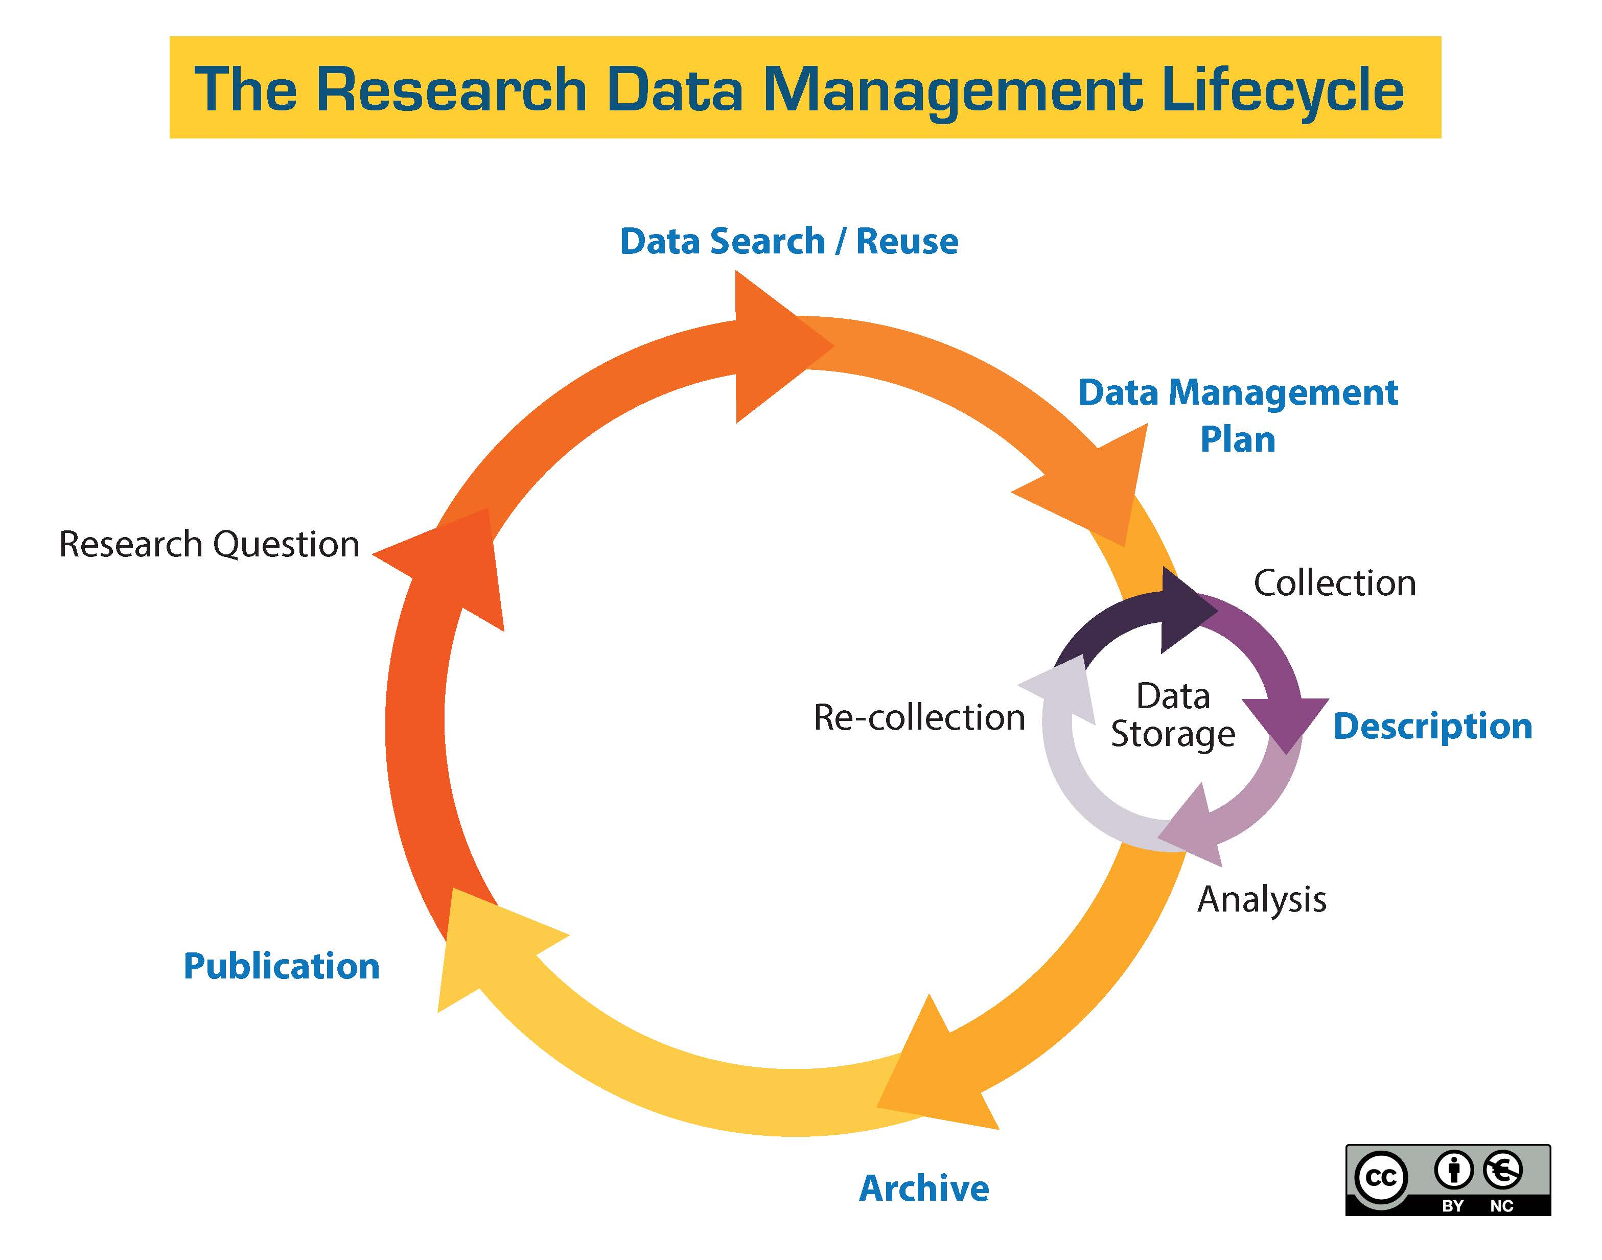
http://guides.library.ucsc.edu/datamanagement/

Slide 6
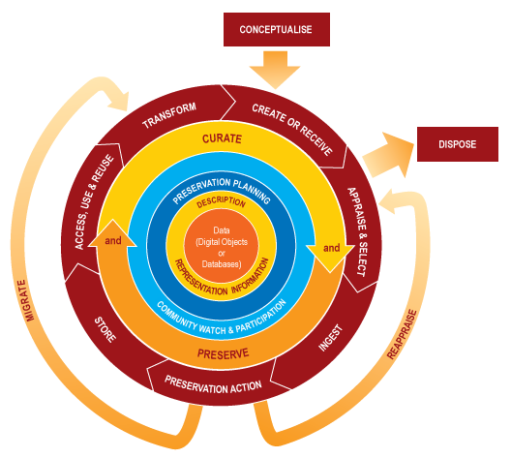
http://www.dcc.ac.uk/resources/curation-lifecycle-model

Slide 7
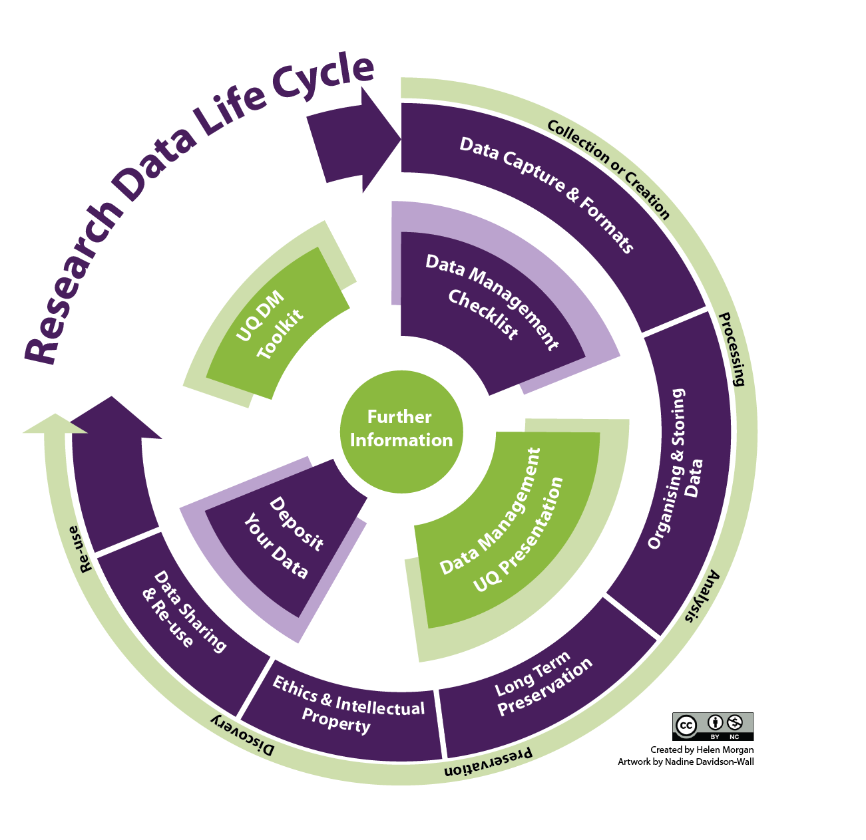
http://libguides.ucd.ie/data

Slide 8
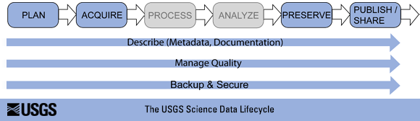
http://www.usgs.gov/datamanagement/images/figures/USGS-data-lifecycle-model.png

Slide 9
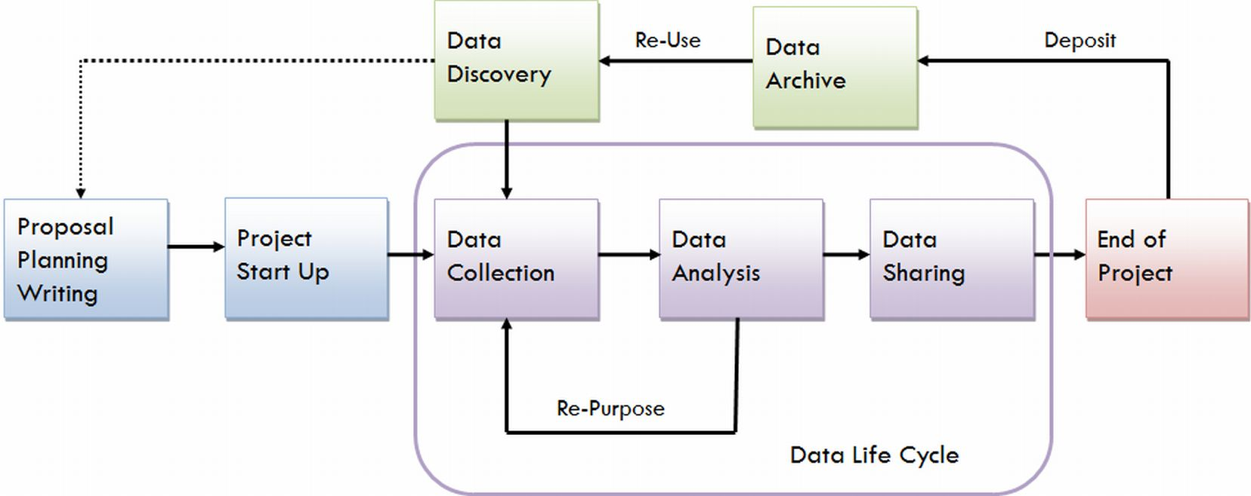
https://data.library.virginia.edu/files/Research-Life-Cycle-LG.png

Slide 10
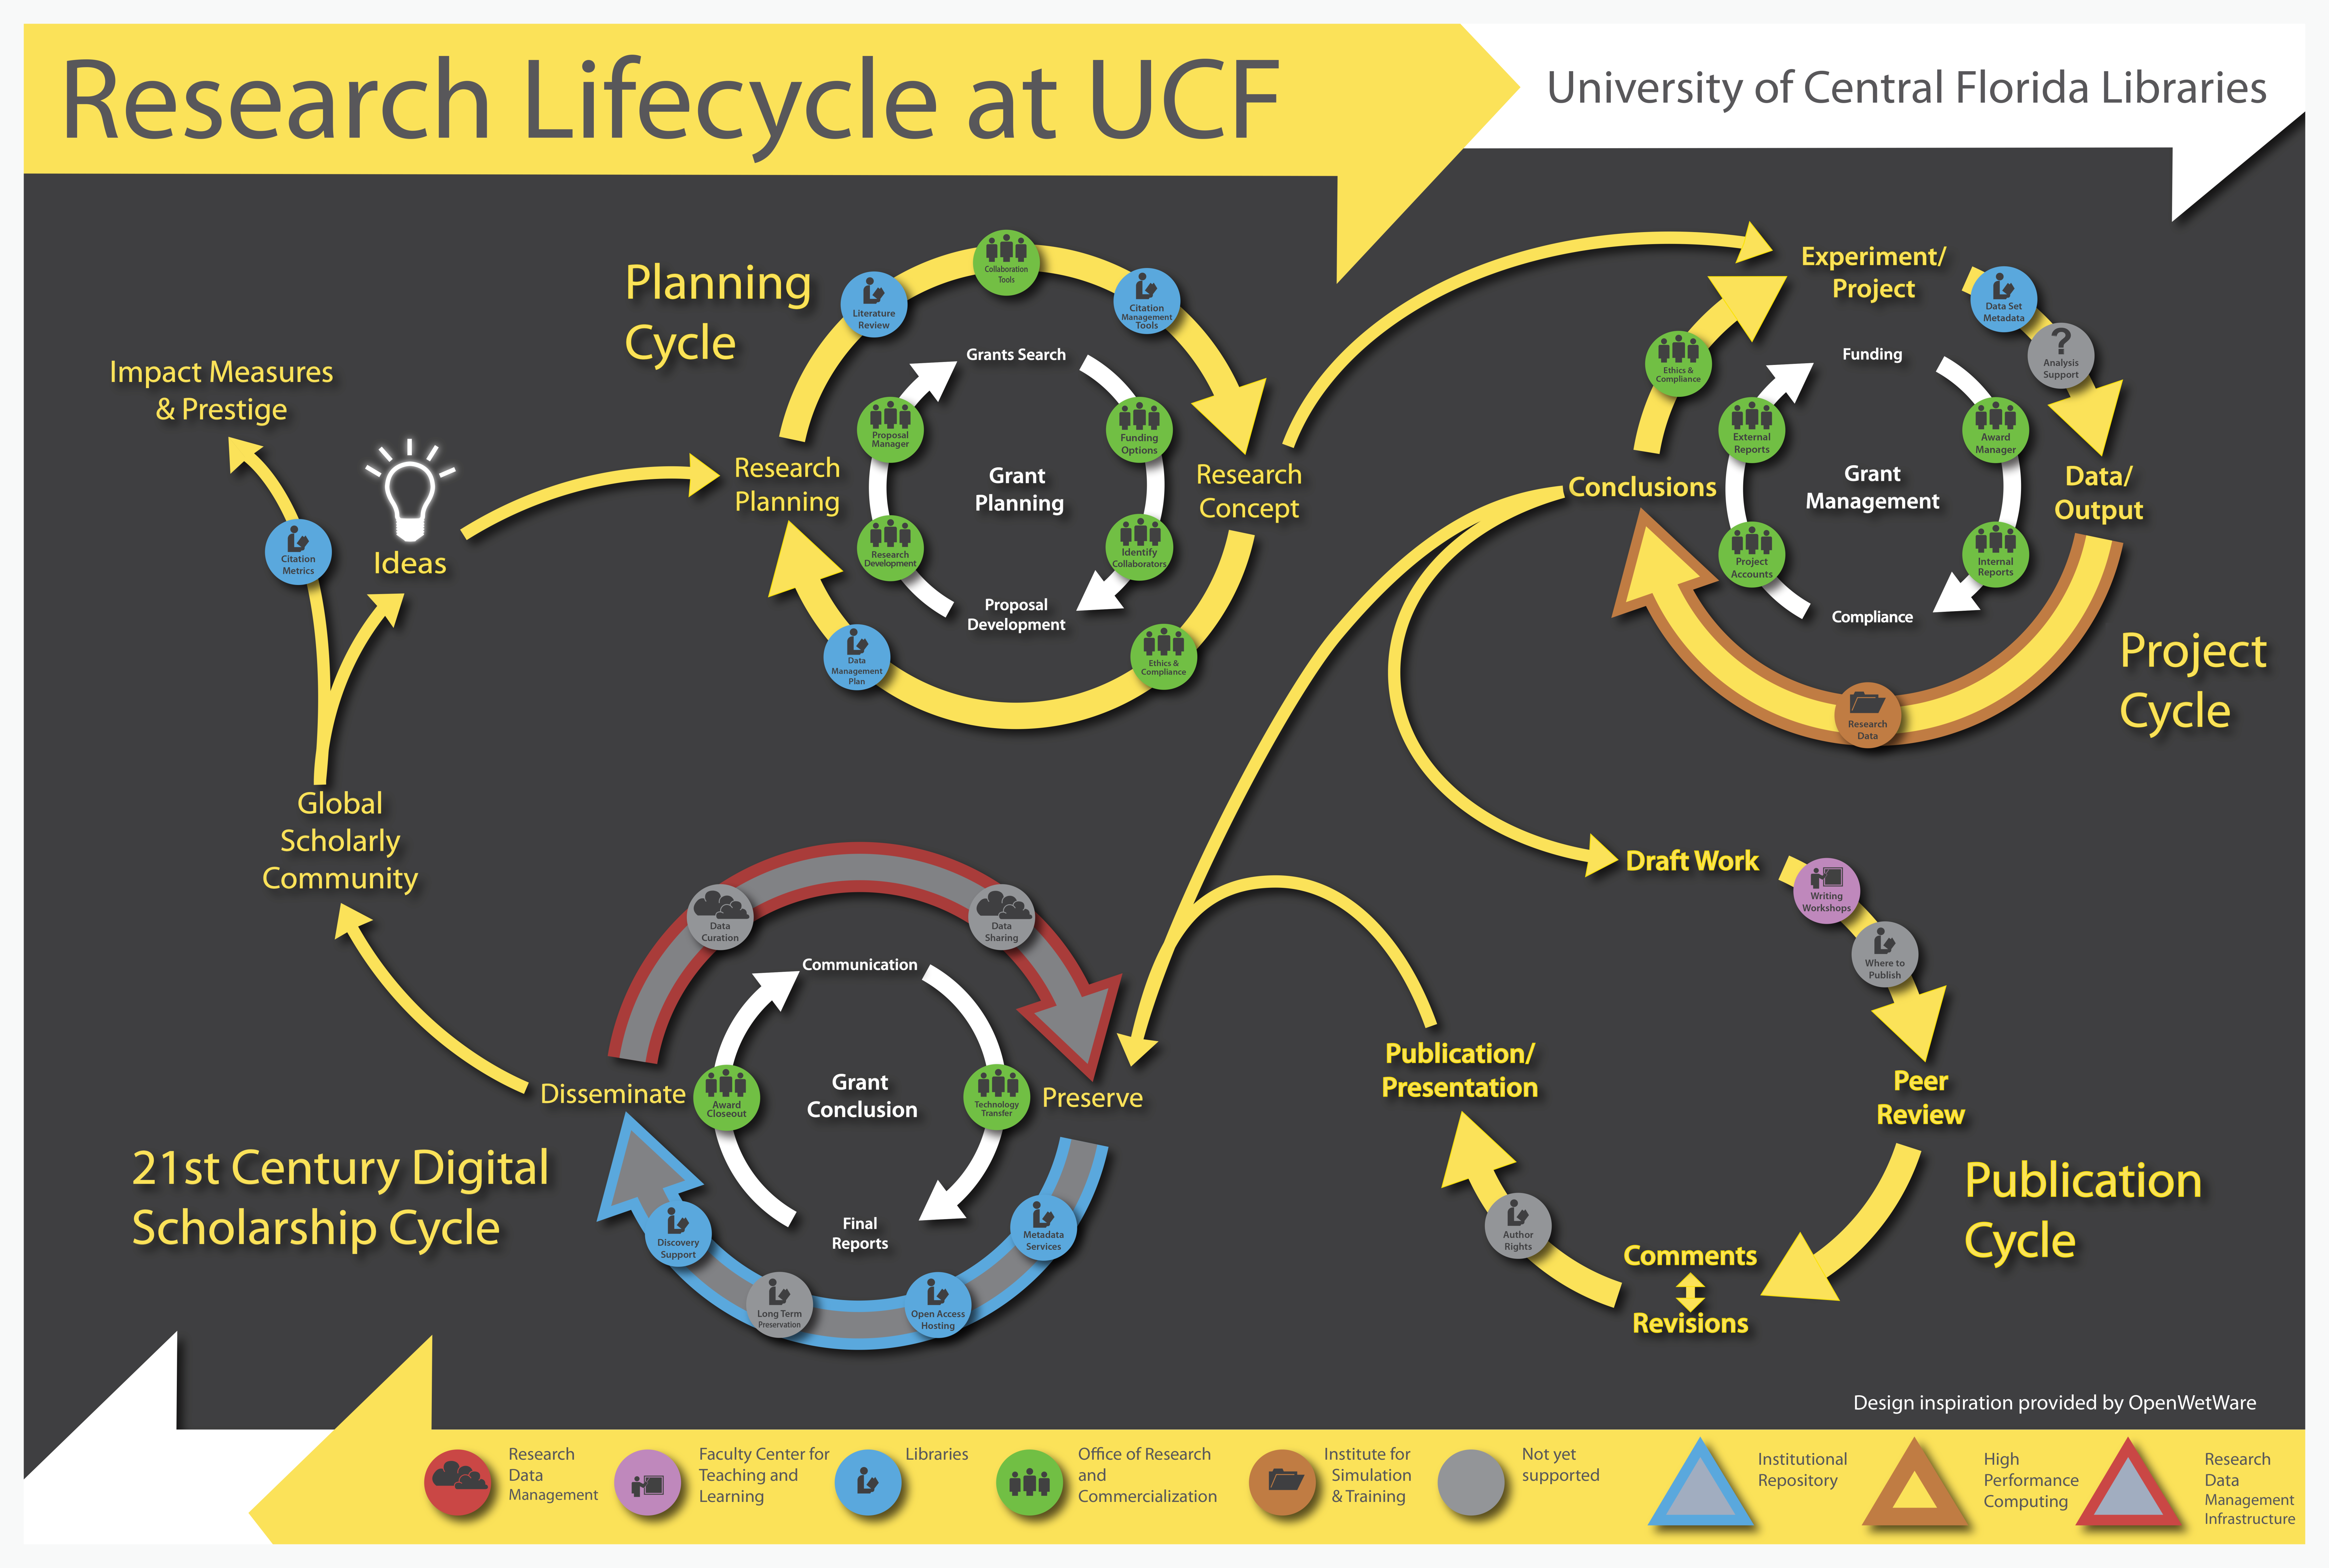
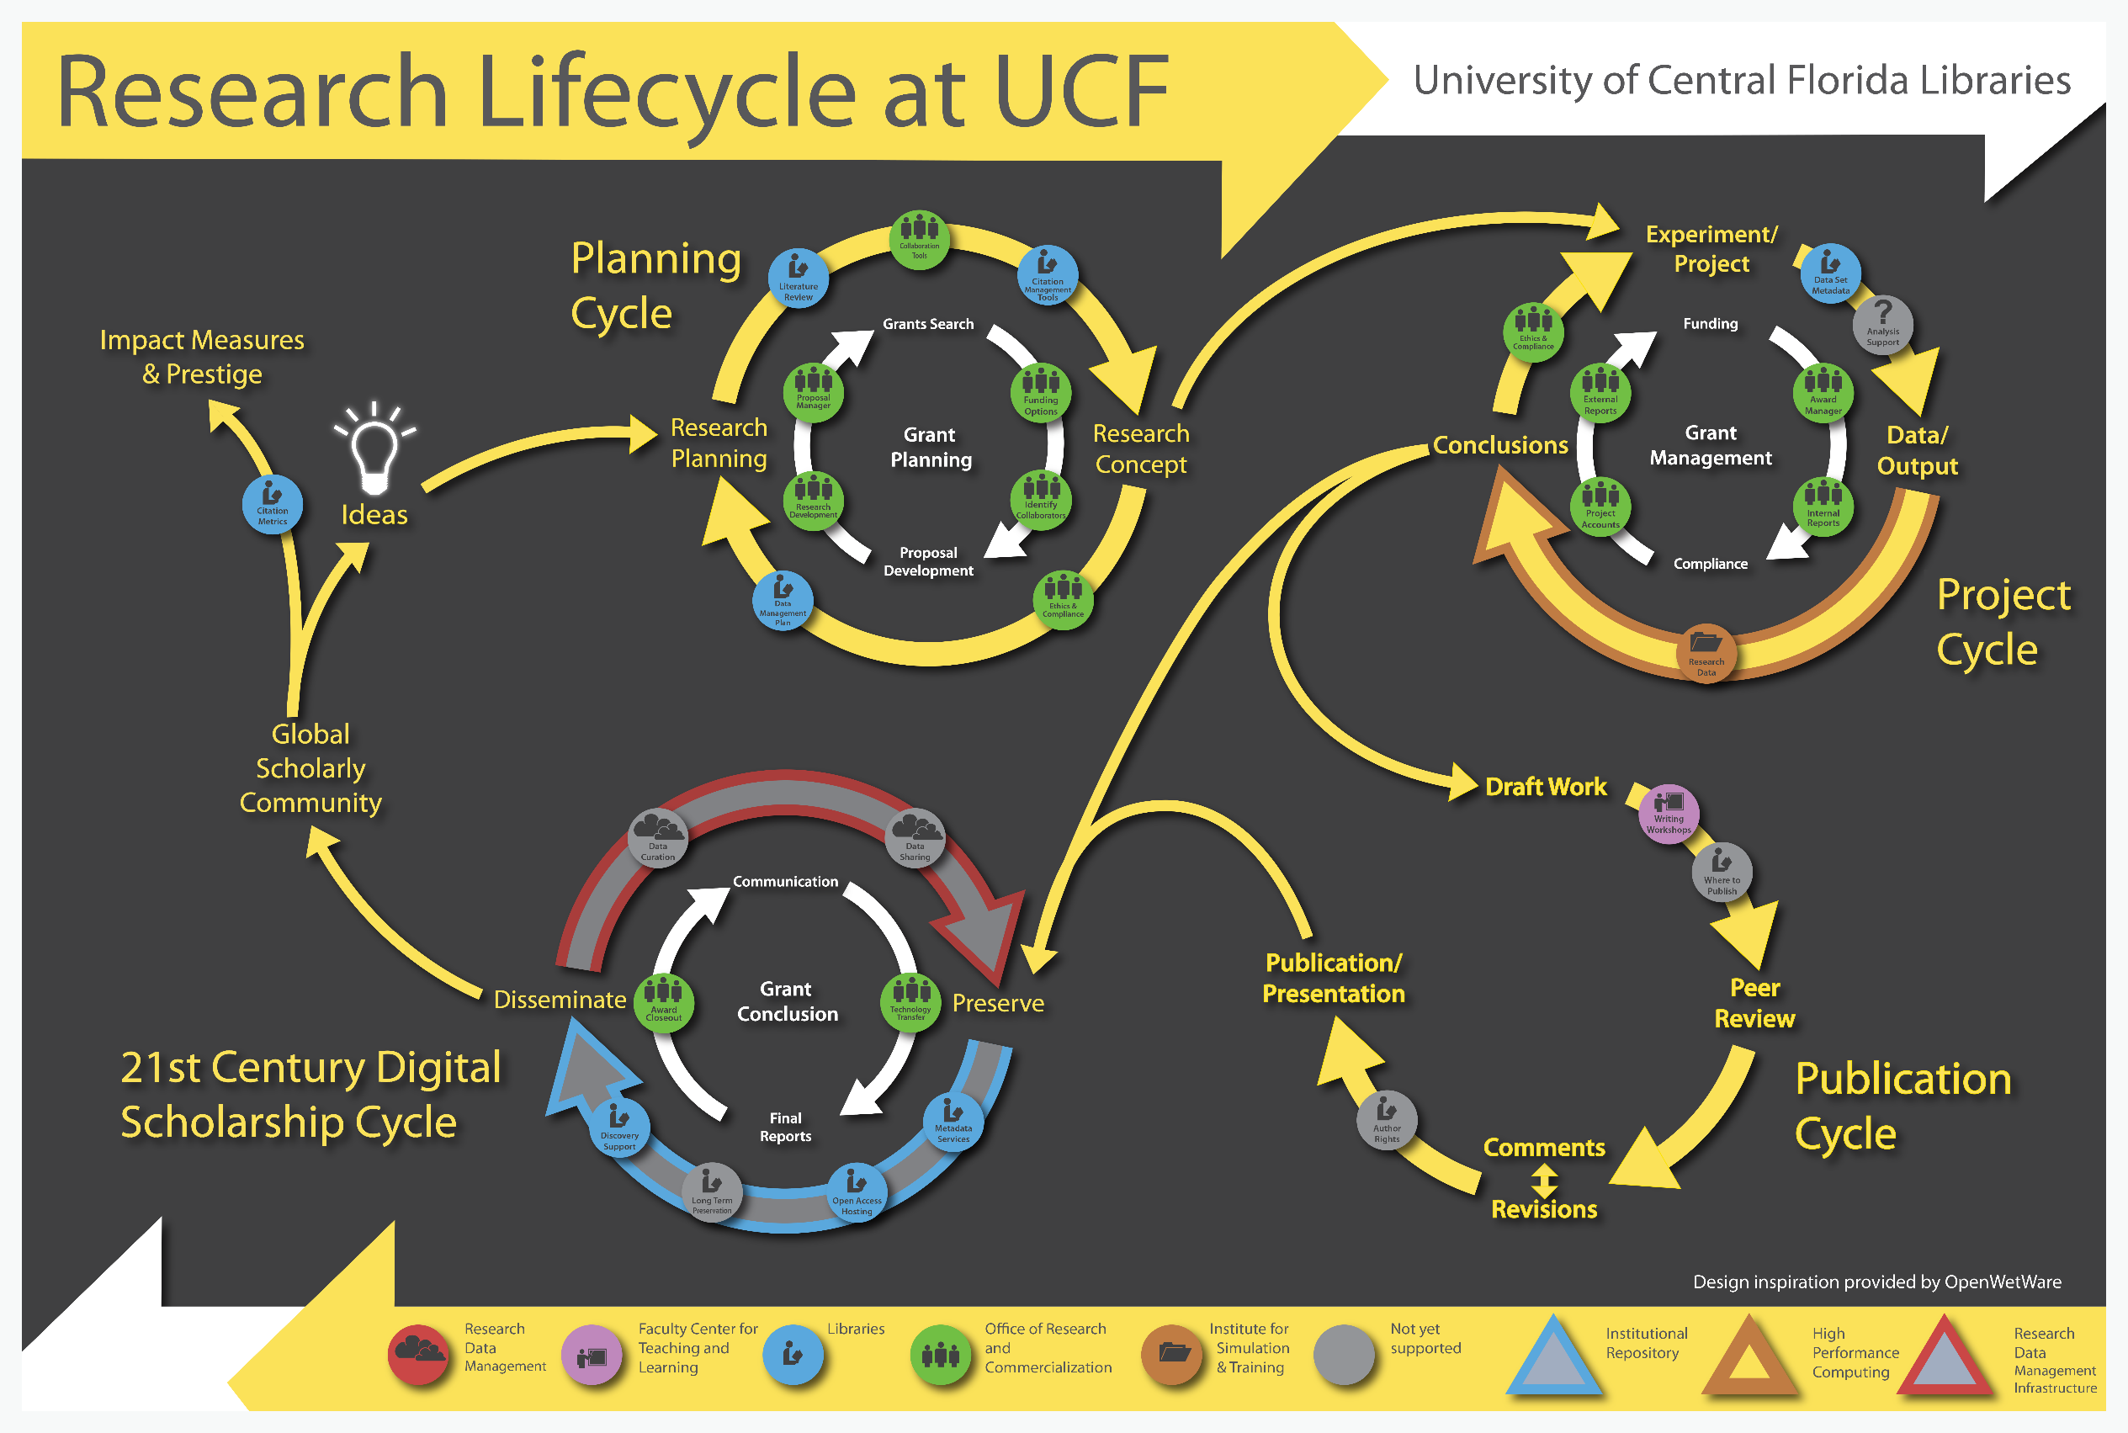

Slide 11
Data Management Plan
Forget about carrots and sticks

